Slide 1
Propositional Logic

Slide 2
Why Do We Need Logic?
Problem-solving agents were very inflexible: hard code every possible state.
Search is almost always exponential in the number of states.
Problem solving agents cannot infer unobserved information.
We want an agent that can reason similarly to humans.

Slide 3
Logic in AI
Logic can be defined as the proof or validation behind any reason provided.
It is simply the ‘dialectics behind reasoning’.
It was important to include logic in Artificial Intelligence because agent (system) to think and act humanly, and for doing so, it should be capable of taking any decision based on the various available options.
There are reasons behind selecting or rejecting an option.

Slide 4
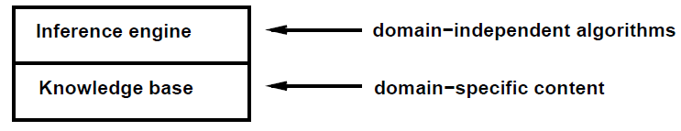
Knowledge Base
Knowledge base: Set of sentences in a formal language
Declarative approach for building an agent
TELL it what it needs to know
Then it can ASK itself what to do - answers should follow from the KB
Agents can be viewed at the knowledge level
What they know, regardless of implementation
Or at the implementation level
Data structures in KB and algorithms that manipulate them.

Slide 5
Logic In General
Logics are formal languages for representing information, such that conclusions can be drawn
Syntax defines the sentences in the language
Semantics define the “meaning" of sentences, i.e., define truth of a sentence in a world
E.g., the language of arithmetic
x + 2 ≥ y is a sentence; x2 + y > is not a sentence
x + 2 ≥ y is true iff the number x + 2 is no less than the number y
x + 2 ≥ y is true in a world where x=7; y =1
x + 2 ≥ y is false in a world where x=0; y =6

Slide 6

Entailment
Entailment means that one thing follows from another
Knowledge base KB entails sentence B iff B is true in all worlds where KB is true
E.g., the KB containing “the Giants won" and “the Reds won” entails “Either the Giants won or the Reds won“
E.g., x + y =4 entails 4=x + y
Entailment is a relationship between sentences (i.e., syntax) that is based on semantics.

Slide 7

Models
Logicians typically think in terms of models, which are formally structured worlds with respect to which truth can be evaluated
We say m is a model of a sentence B if B is true in m
M(B) is the set of all models of B
Then KB |= B if and only if M(KB) M(B)
E.g. KB = Giants won and Reds won
B = Giants won
M(B) could be also true for worlds that are different than the worlds of KB

Slide 8
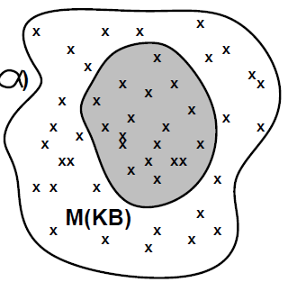
Models
M(B)

Slide 9
Types of logics in Artificial Intelligence
Two types of logics: Deductive logic and Inductive logic
In deductive logic, the complete evidence is provided about the truth of the conclusion made.
Here, the agent uses specific and accurate premises that lead to a specific conclusion.
Example: An expert system designed to suggest medicines to the patient because the person has so and so symptoms.
In Inductive logic, the reasoning is done through a ‘bottom-up’ approach.
The agent here takes specific information and then generalizes it for the sake of complete understanding.
Example: In the natural language processing, an agent sums up the words according to their category, i.e. verb, noun article, etc., and then infers the meaning of that sentence.

Slide 10
Propositional Logic
A proposition is a declarative statement which is either true or false.
It is a technique of knowledge representation in logical and mathematical form.
(a) The Sun rises from West
(b) 5 is a prime number.
In PL, symbolic variables are used to represent the logic.
PL consists of an object, relations or function, and logical connectives, called logical operators.
A proposition formula which is always true is called tautology, and it is also called a valid sentence.
A proposition formula which is always false is called Contradiction.

Slide 11
Syntax of propositional logic
There are two types of Propositions:
Atomic Propositions
Compound propositions
Atomic Proposition: Atomic propositions are the sentences which must be either true or false.
Compound proposition: Compound propositions are constructed by combining simpler or atomic propositions, using parenthesis and logical connectives (It is raining today, and street is wet)

Slide 12
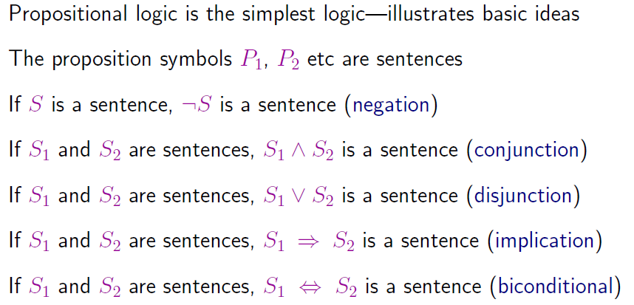
Propositional Logic
Order of Precedence
27 January 2025
If and Only If
If S1 then S2
12

Slide 13
Logical Connectives
Negation: A sentence such as ¬ P (negation of P) is a literal can be either Positive literal or negative literal.
Conjunction: A sentence which has ∧ connective such as, P ∧ Q is called a conjunction.
Disjunction: A sentence which has ∨ connective, such as P ∨ Q. is called disjunction, where P and Q are the propositions.
Implication: A sentence such as P → Q, is called an implication. Implications are also known as if-then rules. It can be represented as If it is raining (P), then the street is wet (Q), represented as P → Q
Biconditional: A sentence such as P⇔ Q is a Biconditional sentence,
If I am breathing (P), then I am alive (Q)

Slide 14
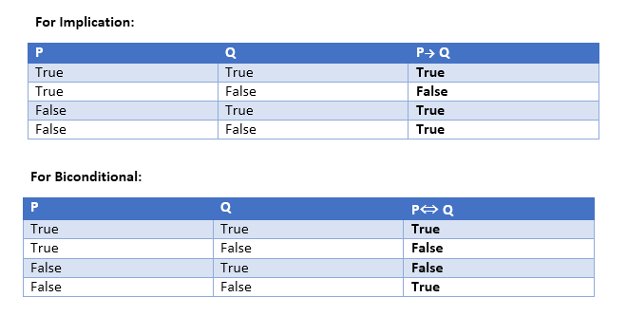

Slide 15
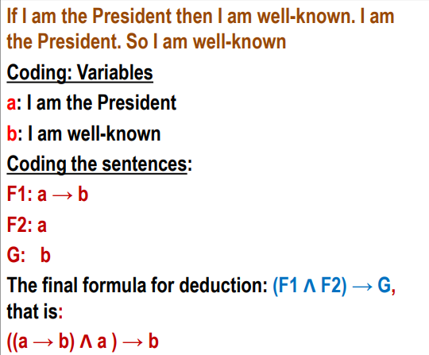
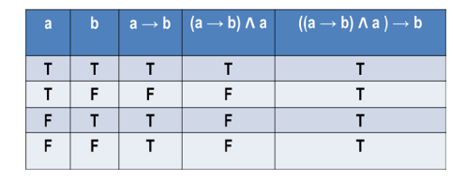
Deduction using Propositional Logic
Limitations of Propositional logic:
Cannot represent relations like ALL, some, or none with propositional logic. Example: All the girls are intelligent, Some apples are sweet.

Slide 16
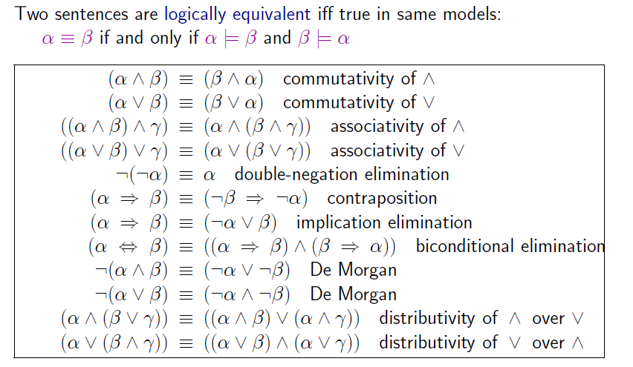
Logical Equivalence
27 January 2025
16

Slide 17
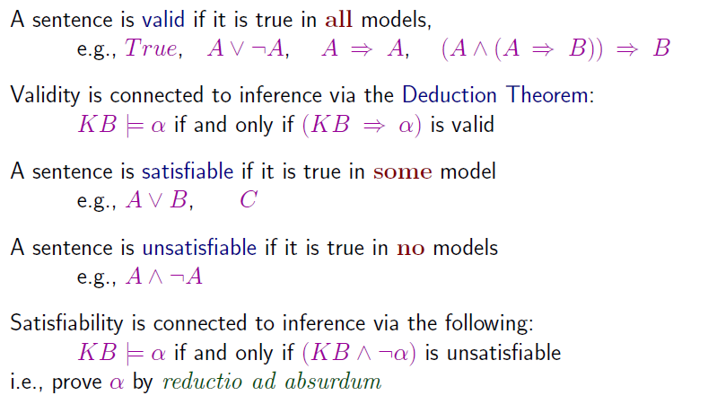
Validity and Satisfiability
If KB is true, alpha is always true. Hence, I can say that alpha follows from KB
Suppose that KB=true. Then, this will become unsatisfiable only when alpha is true. Hence, I can say that alpha follows from KB
27 January 2025
17

Slide 18




Two Famous Inference Rules
Modus Ponens
And Rule
Given that P implies Q, and I know that P is true, then I can infer Q
Given that P AND Q is true, I can infer that P is true, and I can also infer that Q is true.
27 January 2025
18

Slide 19
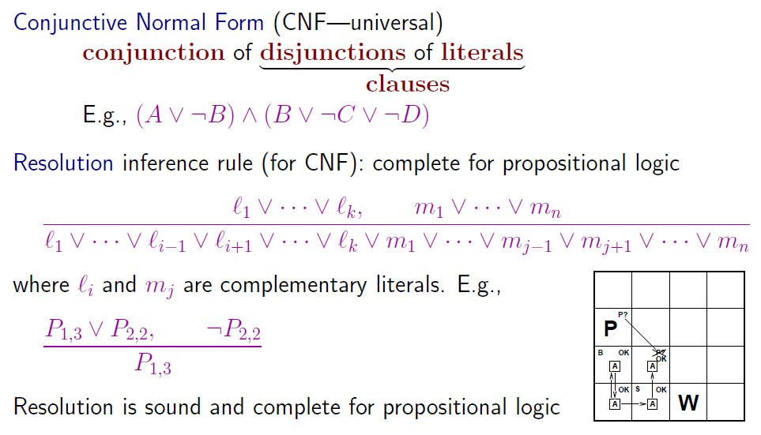
Resolution
27 January 2025
19

Slide 20
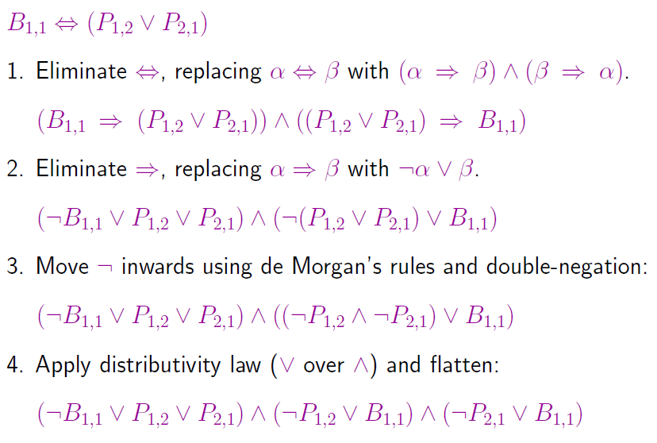
Conversion to CNF
27 January 2025
20

Slide 21
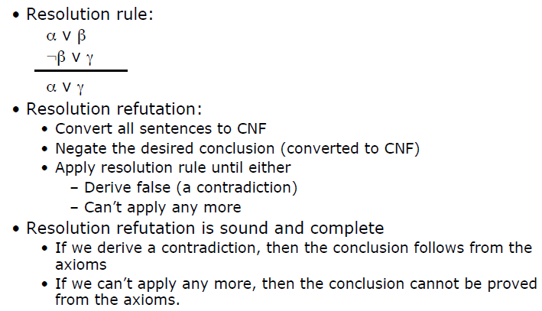
Resolution Algorithm
27 January 2025
21

Slide 22
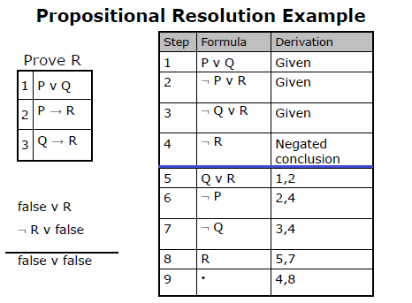
Example
27 January 2025
22

